Slide 1

Rockbuster Stealth: Data Analysis Summary
Shaili Oza, March 15, 2023

Slide 2

PROJECT CONTEXT
Context: The Rockbuster Stealth management team is planning to use its existing movie licenses to launch an online video rental service in order to stay competitive market of services such as Netflix and Amazon Prime.
We will be answering the management’s key questions to assist the company strategy.
Look for the to see where these key questions are being answered.
What movies contributed the most/least to revenue gain?
ANALYSIS BY COUNTRY
Which countries are Rockbuster customers based in?
Where are customers with a high lifetime value based?
Do sales figures vary between geographic regions?
What was the average rental duration for all videos?

Slide 3
SUMMARY STATISTICS
# of Movies in our Catalog:
1000
Release Year:
2006
Language(s):
English
Breakdown of Ratings:
Longest Film(s)
185 min.
Average Film(s)
115 min.
Shortest Film(s)
46 min.
# of Active Customers:
584
Countries:
109
# of stores:
2
Rental Rate
Maximum: $4.99/day
Average: $2.98/day
Minimum:
$0.99/day
Rental Duration:
Maximum:
7 Days
Average:
5 Days
Minimum:
3 Days
The average rental duration for all videos is 5 days.

Slide 4
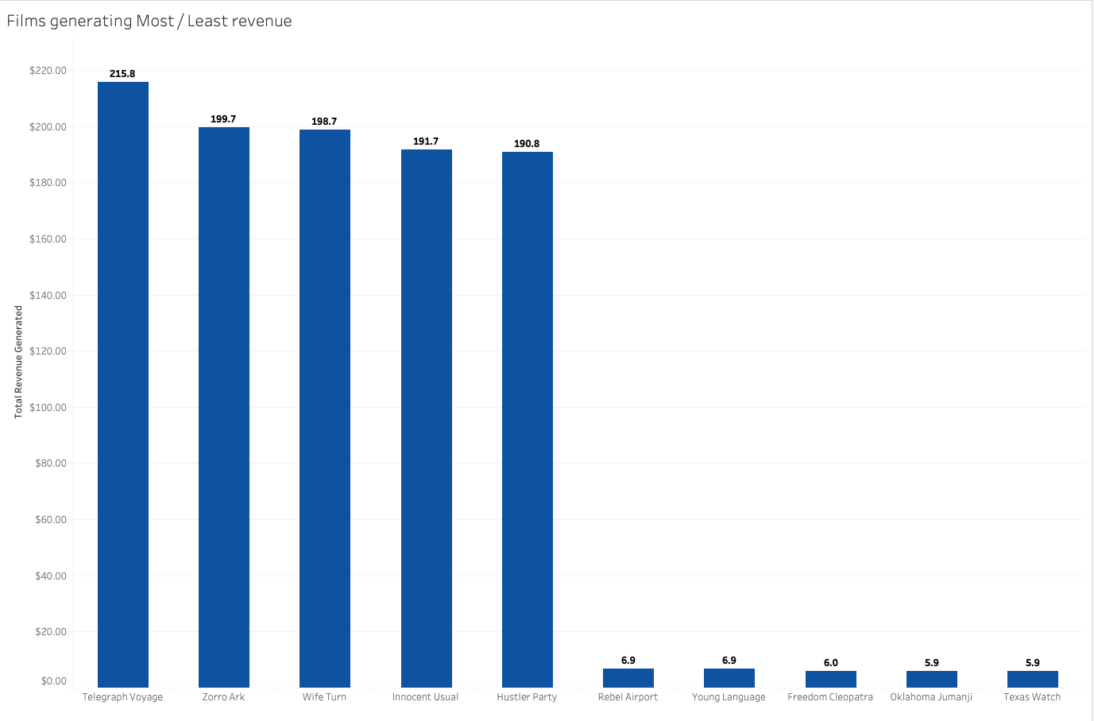
ANALYSIS
The top 5 films that generated maximum revenue are:
Telegraph Voyage ($215.8)
Zorro Ark
Wife Turn
Innocent Usual
Hustler Party
The films that generated least revenue are:
Rebel Airport
Young Language
Freedom Cleopatra
Oklahoma Jumanji
Texas Watch ($5.9)

Slide 5
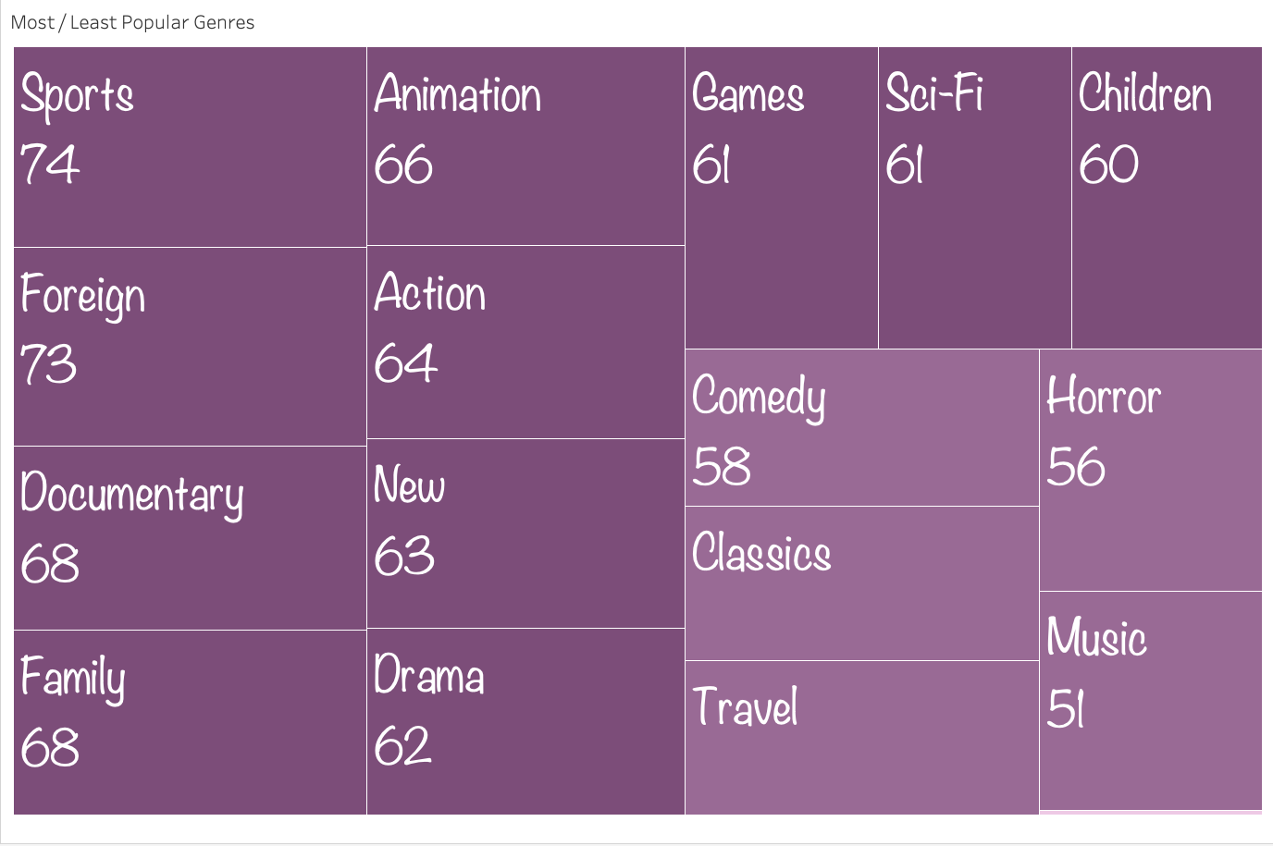
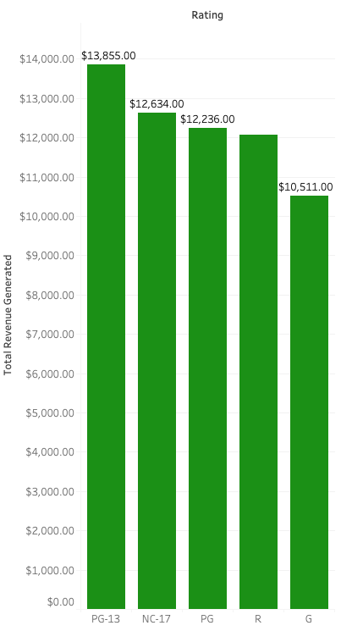
ANALYSIS
What genres and ratings bring in the most revenue?
The first chart shows that the top 5 Genres to generate revenue are Sports, Foreign, Documentary, Family and Animation.
The second chart shows that the most revenue generating movie rating is PG-13, followed by NC-17, PG, R and lastly G.

Slide 6
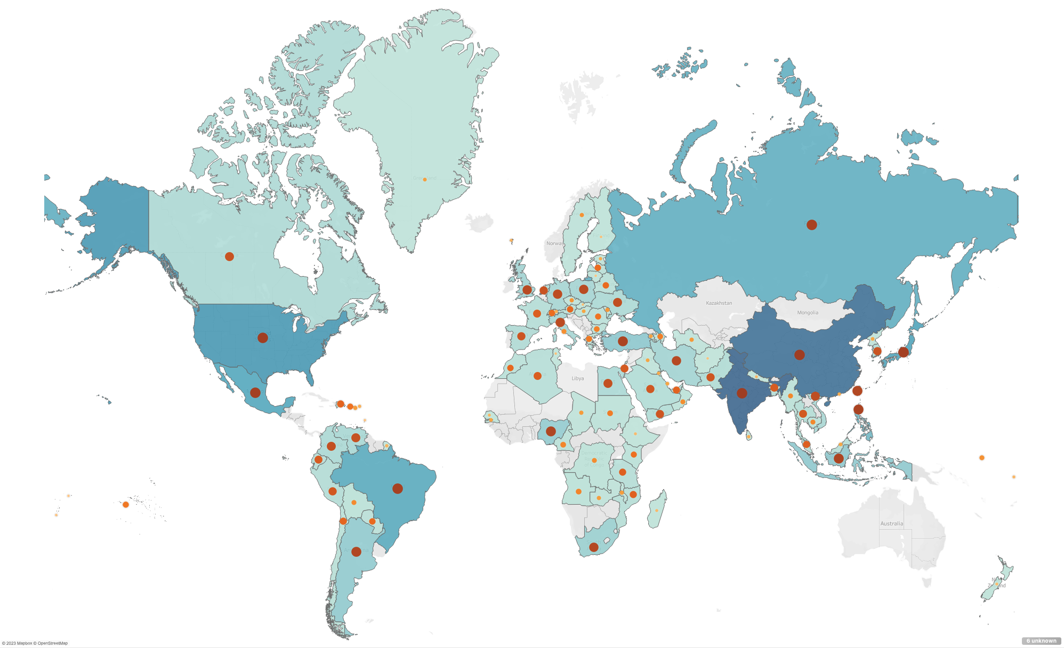
ANALYSIS
Top 10 countries by customer count and revenue generated
The map shows customer distribution of Rockbuster in different countries. The darker countries show more number of customers.
The shades of orange show revenue generated by each country. The darker the shade, the more the revenue generated.
Number of Customers | Revenue Generated | Country
1422 | 6035 | India
1297 | 5251 | China
869 | 3685 | United States
749 | 3123 | Japan
718 | 2985 | Mexico
681 | 2919 | Brazil
638 | 2766 | Russian Federation
530 | 2220 | Philippines
351 | 1498 | Turkey
331 | 1353 | Indonesia
https://public.tableau.com/app/profile/shaili.oza/viz/RockbusterBubble_16789034892530/Sheet4?publish=yes

Slide 7
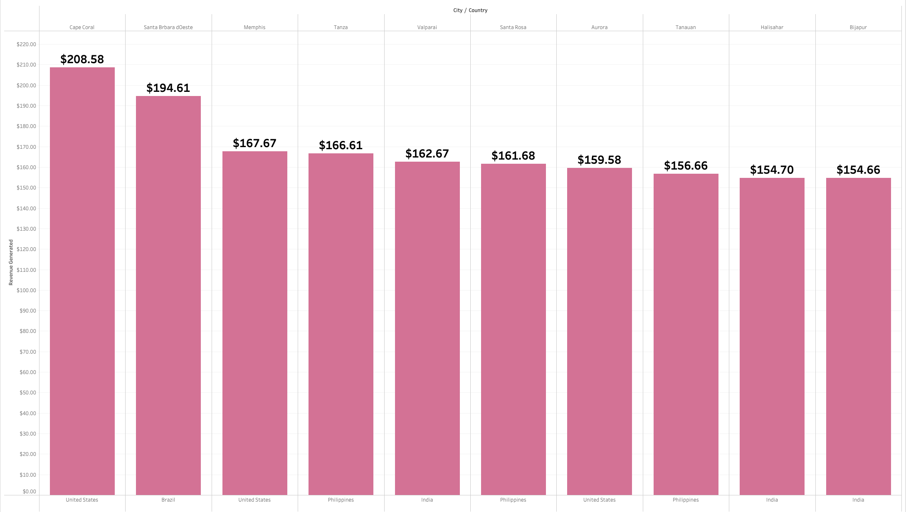
ANALYSIS
Top 10 Cities within the top 10 countries for Rockbuster based on customer payments
The top 10 cities are Cape Coral, Santa Barbara, Memphis, Tanza, Valparai, Santa Rosa, Aurora, Tanauan, Halisahar and Bijapur
These cities represent customers with a high lifetime value

Slide 8
CONCLUSIONS AND RECOMMENDATIONS
CONCLUSIONS | RECOMMENDATIONS
Our analysis shows us which countries generate most revenue and also which cities have customers with high lifetime value. It also shows where revenue is least generated and demographic distribution of customers around the world | We can show appreciation for our customers’ loyalty in the form of discounts or perks. We can also investigate into low turnover regions and identify the reasons for low number of customers; in order to rectify that.
Our data shows which genres are most popular | Based on that, we can make more movies of similar genres available to the customers to increase revenue.
Majority of movies have a low rental rate of $0.99/day. | Rockbuster can continue providing that rental rate to attract new customers. Moreover, we can also increase the number of movies in popular genres and provide them at the rate of $4.99/day, to further increase out revenue.
The recommendations can be used to form a new launch strategy for increasing the number of stores and new online video services.

Slide 9
DATA LIMITATIONS
Our dataset only contained English language films released in 2006. Moreover, the customer revenue was based on rental dates from 05/24/2005 – 02/14/2006. This amount of data is very less to make a successful analysis for future predictions. |  | We should expand our dataset to include non-English language films released in various years to see if other languages are more successful across our customer base. We should look at more recent sales transactions, as well.

Slide 10

For any questions and queries, kindly contact SHAILI OZA

